Slide 1
Attacking Active Directory (AD)

Slide 2
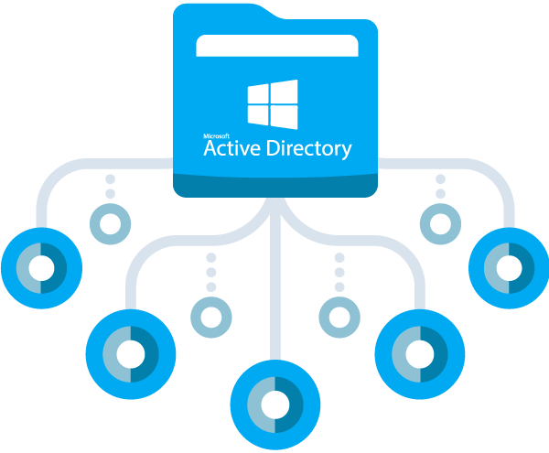

Slide 3
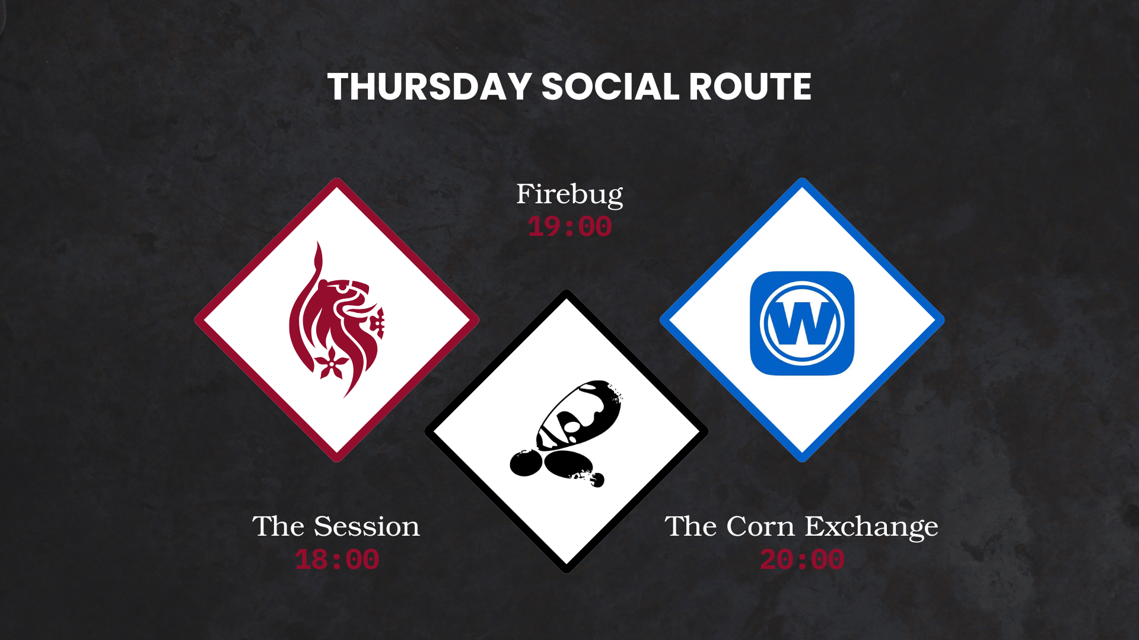

Slide 4
ANNOUNCEMENTS
P2P signups are open, please see the discord for more info!
Upcoming sessions will be focused on P2P preparation and CTF training
Go get the CTF club role so you can join the upcoming events! (Sheffield CTF)

Slide 5
SUMMARY
Common AD attacks
Tools for exploitation
ADCS attacks
Using Bloodhound for lateral movement

Slide 6
ATTACKS ON
KERBEROS (PORT 88)

Slide 7
KERBEROASTING – WHAT IT IS?
Imaging a scenario of a corporate building where everyone needs a badge to get in.
You walk into the lobby and ask the receptionist for a data packet for the "SQL Database Service." The receptionist gives you a sealed envelope addressed to that service. The envelope is locked with a padlock that is based on that service's password. You take that envelope and leave the building. You don't need to open it on the spot. Later, at your own computer, you try every possible combination until the padlock clicks open. Once it does, you know the service's password.
Notes:
NOTE: This attack is not specific to service accounts it can happen to any account on the domain

Slide 8
KERBEROASTING – HOW ITS EXPLOITED
Finding the target - The attacker, who is already a normal user on the domain, queries Active Directory to find all "Service Principal Names" (SPNs). These are basically labels that say, "This account runs a specific service.“
Requesting the ticket - The attacker requests a service ticket for that specific service from the Domain Controller. The Domain Controller sees the request and provides it.
Hash cracking - The ticket sent by the Domain Controller is encrypted using the password hash of the account. This can be cracked using tools like hashcat and john to retrieve that users password.
Notes:
This can be exploited with a tool called NetExec
Also worth noting this attack requires credentials on the domain in order to request a ticket from the domain controller
A user must be in the Kerberos database in order to get their hash, so if there isn’t any users in this database this attack is not possible

Slide 9
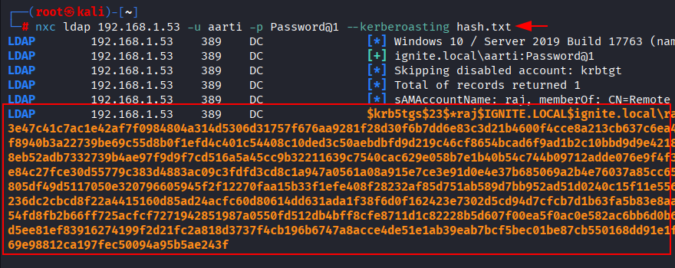
KERBEROASTING EXAMPLE USING NETEXEC
Notes:
As seen from this image theyre specifying the protocol as well as the target ip a domain name works as well.
Both username and password require as previously mentioned
They specify the attack as a flag and also a text file to save the hash to, to make cracking easier

Slide 10
AS-REP ROASTING – WHAT IT IS?
Imaging a scenario of a corporate building where everyone needs a badge to get in.
AS-REP Roasting is like finding an employee who accidentally left their window open at night. Instead of going through the front door (pre-authentication), you just climb through the window. Once you're inside their office, you grab their personal notebook. That notebook is locked with a simple combination lock based on their birthdate. You take the notebook home and crack the combination to read all their personal information.
Notes:
So the end of the attack is similar to keberoasting, you retrieve a hash which is then crackable using john or hashcat
The main difference is this only requires a username, whereas kerberoasting requires a username and password
You can also use a list of users, if you have a list of valid users then you can attach the list and nxc will try to as-rep roast every user in the list
Once again not always possible. Kerberos pre-authentication must be disabled for a user account for this to work
This option exists if you have a user that does not want to be prompted for a password all the time.

Slide 11
AS-REP ROASTING – HOW ITS EXPLOITED
Username enumeration – An attacker would first need a username or a list of users (We will speak about this later)
Impersonate the user – Since the user is not required to enter a password an attacker can pretend to be that user and request a ticket
Retrieve hash - Because pre-authentication is off, the Domain Controller doesn't challenge the request. It send the hash to the user to be cracked just like before.
Notes:
So I would like to point out this attack works better with a wordlist of users on the domain. This way you don’t actually have to know if pre-authentication is disabled
You can just run nxc with a user list and if its possible to as-rep roast them youll get a password hash. Should be shown on the next slide

Slide 12
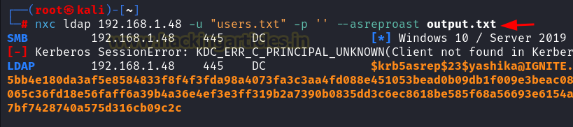
AS-REP ROASTING - EXAMPLE USING NETEXEC
Notes:
So similar to kerberoasting, you specify the protocol and target
Specify the list of users on the domain. And since this attack does not require creds you leave password blank
Then specify the type of attack and also the file you want to save a potential hash to.
If a user does not have pre authentication disabled then that user will fail, but nxc will cycle the users in the list to find one that is disabled then will request hash

Slide 13
ATTACKS ON
SMB (PORT 139,445)

Slide 14
SMB SHARES
If you have ever used a network drive, you were using SMB. Think of this protocol as a way of accessing and collaborating on files in a single space.
When SMB is setup there is default shares and non-default shares
Most of the time default shares won't hold anything sensitive, but it's common to have non-default shares that can sometimes hold passwords or other sensitive information.
Notes:
Default shares:
ADMIN – Requires admin privileges a lot of the time
C$ - Requires admin privileges a lot of the time
IPC$ - Most users can access
NETLOGON - Most users can access
SYSVOL - Most users can access

Slide 15
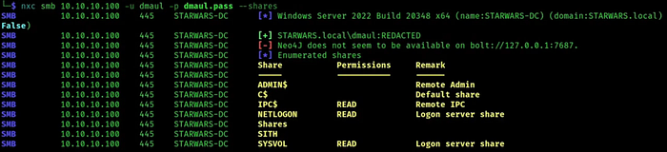
SMB SHARES – EXAMPLE
Notes:
As seen here nxc can be used to list access to all the shares on the system. Specify protocol, target, as well as credentials. Then finally use the “—shares” to list this
In this example the user “dmaul” has read access on some of the default shares but none on the admin shares or the non-default shares

Slide 16
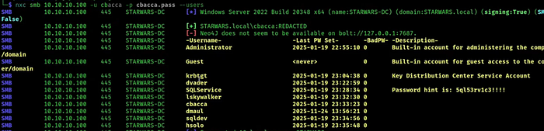
ENUMERATING USERS USING SMB
Notes:
Its also possible to list all users on the active directory domain using “—users”
This goes back to what we spoke about earlier with getting a user list for asrep roasting
Also notice a password hint in the account description in this example its for the account SQLservice
This is common in not only CTFs but also the real world. IT staff change passwords every so often and they will place it here for you to see!

Slide 17
NULL AUTHENTICATION IN SMB
So null authentication refers to a configuration on SMB that will allow you to authenticate to SMB without credentials.
This allows you to do things like list shares as well as list users and groups in the AD domain
The term null authentication simply means a blank username and password.

Slide 18
NULL AUTHENTICATION – EXAMPLE
Examples:
nxc smb <target> -u ‘’ –p ‘’ –shares
- This command will use null authentication to enumerate the shares on the domain
nxc smb <target> -u ‘’ –p ‘’ –users
- This command will use null authentication to enumerate the users on the domain
nxc smb <target> -u ‘’ –p ‘’ –rid-brute
- This command will use null authentication to dump users and groups on the AD domain
Notes:
--rid-brute can sometimes work when --users doesn’t work. It also provides more info typically but does not display account descriptions
So its always worth running both in the enumeration phase

Slide 19
GUEST AUTHENTICATION ON SMB
AD domains typically have a guest account, this account can be used to enumerate the AD environment
It can be used to access SMB shares as well as dump users and groups on the AD domain
Its best practice to disable this account so that attackers cannot use this to their advantage

Slide 20
GUEST AUTHENTICATION – EXAMPLE
Examples:
nxc smb <target> -u ‘guest’ –p ‘’ –shares
- This command will use guest access on SMB to enumerate the shares it has access to
nxc smb <target> -u ‘guest’ –p ‘’ –users
- This command will use guest access on SMB to enumerate the users on the domain
nxc smb <target> -u ‘guest’ –p ‘’ –rid-brute
- This command will use guest access on SMB to enumerate the users and groups on the domain
Notes:
Once again always worth trying all these in the enumeration phase. It may be only one of them works.

Slide 21
WATERING HOLE ATTACK
This attack occurs when you have write access to an SMB share. This privilege is common in the real world
You can use a tool called ‘ntlm_theft’ to craft malicious files with your IP address embedded inside.
You then spin up a tool called “responder” which acts as a listener
Then you can use “smbclient” to connect to the share and plant the files in the share
Once another user accesses these files you will retrieve their NetNTLMv2 hash which is then crackable
Notes:
This attack relies on someone else accessing your malicious files.
I have made one of my walkthroughs to a machine I did recently public so you can see the attack process.

Slide 22
BLOODHOUND – WHAT IS IT?
Bloodhound it a tool that is used to map out Active directory, it can be used to find certain privileges tied to an account.
It can also be used to find outbound object control over another account.
Built-in queries that you can run against the domain controller that help with things like privilege escalation.
“Members” feature which makes it easy to see which user is part of which group.
Notes:
Bloodhound is always one of the first things you should run when you get credentials

Slide 23
LOOT COLLECTION
In order to run bloodhound you need to collect the loot by querying the domain controller
This process will provide you with either a .zip file or several .json files that can be imported into bloodhound
This is required to run bloodhound, but the process itself is very simple

Slide 24
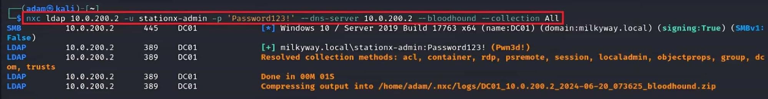
BLOODHOUND LOOT COLLECTION – EXAMPLE
Notes:
So similar to other nxc commands. You use protocol, target, credentials.
But this time you specify the DNS server, which in most cases is just the target ip address.
You then speicfify bloodhound and the collection type which should always be “All”

Slide 25
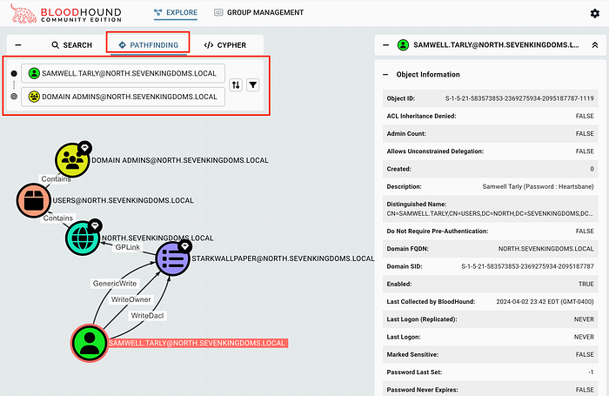
BLOODHOUND – PATHFINDING FUNCTIONALITY
Notes:
This is a functionality in bloodhound that allows you to map out a path from one user to another
This is helpful if youre trying to achieve domain admin, you simply set the start node to your current user to the administrator
This will map out a path for you.
Its also worth noting the search function which allows you to search for a specific user and after clicking into It account info is displayed on the right

Slide 26
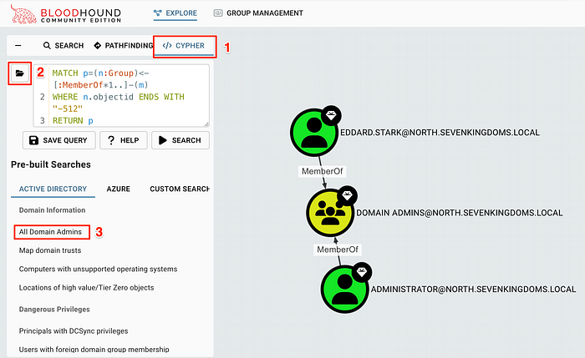
BLOODHOUND – CYPHER FUNCTIONALITY
Notes:
This functionality comes with several saved querues which you can run to help map out the domain easier
For example, in this screenshot the user has ran the query all domain admins and they’ve been shown all the users in the domain admins group
Notice the other querues that are there. “Principals with DCSync” this shows all objects with DCSync rights. I will explain that more later

Slide 27
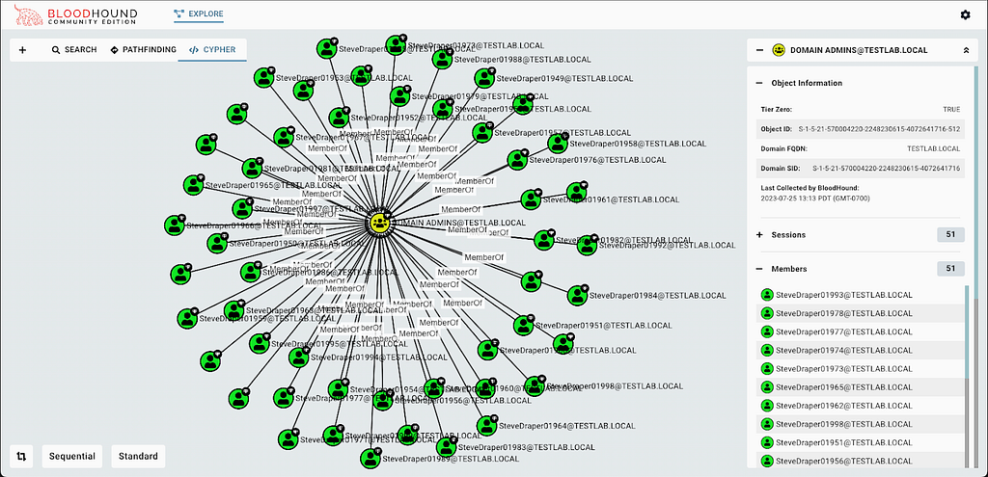
BLOODHOUND – MEMBERS FUNCTIONALITY
Notes:
As seen on the right panel, after searching for an object you can click into it and select the members tab
This will show all the groups that the specific user is a part of
Key ones would be:
Remote management users
Remote desktop users
Which both allow remote access

Slide 28
BLOODHOUND – OUTBOUND OBJECT CONTROL
Possibly an attackers most important asset in bloodhound
This functionality allows an attacker to view the control their current user has over another
So if an attacker has compromised a user called “steve.smith” they can search for this user and open their outbound object control
This will show what privileges “steve.smith” has over another
These are key for things like lateral movement

Slide 29

BLOODHOUND – OUTBOUND OBJECT CONTROL EXAMPLE
Notes:
So here ive searched for the user yorinobu and similar to the members functionality
I can click on the node itself and at the bottom of the panel on the right there is outbound object control
This will open something similar to this. In this example I have “GenericWrite” over another user which means I can control his account in certain ways to move laterally
There is also inbound object control but that is just the control another has over you. So not nearly as interesting. Now ill be explaining some of the privileges you can have on outbound object control but only the most common as there is a lot

Slide 30
BLOODHOUND - GENERICALL
This privilege is basically full control over the other node
It means you could change their password without knowing their current password.
Another option would be to perform a targeted kerberoast on the user by adding them to the Kerberos database then retrieving their hash
The final option is to apply shadow credentials, this is where an attacker will add their public key to the list on the target user. Which in turn means that they can authenticate as the new user
Notes:
Its also worth noting that the shadow creds attack is the most common in the real world.
On pen test engagements its unethical to change a users password without client permission so this isn’t really used
A targeted kerberoast of course depends on the security of the users password. If it’s a really secure password then you wont be able to crack it so that attack can be useless quite often
So therefore shadow creds attack works the best in the real world

Slide 31
BLOODHOUND – GENERICWRITE
This privilege is similar to GenericAll only you do not have the option to change the users password
You can still perform shadow credential attacks and a targeted kerberoast

Slide 32
BLOODHOUND – FORCECHANGEPASSWORD
This is a privilege that only allows you to change the outbound nodes password
With this privilege you can't perform shadows credential or a targeted kerberoast on the outbound node
This is still a very powerful privilege to have as it guarantees a compromise of another user

Slide 33
BLOODHOUND - DCSYNC
This is a very powerful privilege to have on a domain
With this privilege you can simply dump all the NTLM hashes of all users on the domain including the highest privileged users like the domain admins
NTLM hashes also do not require cracking, you can use an NTLM hash as an alternative to a password and authenticate to the domain
This means that with this privilege you can dump the admin hash and authenticate as them all in two commands
Notes:
Please note there are a lot more privileges that you can have on outbound object control
But these are the most common

Slide 34
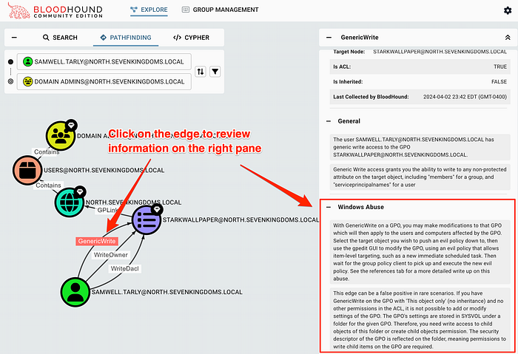
BLOODHOUND – PRIVILEGE ABUSE
Another cool feature for bloodhound is that when you find you have a certain privilege on outbound object control, you can click the privilege itself
This will bring up an abuse tab which will give you the commands you need to run to abuse this, all you need to do is fill in the appropriate info in the command
Notes:
There is options for both windows and linux. If youre attacking from a linux machine you want “linux abuse”

Slide 35
ADCS ATTACKS

Slide 36
WHAT IS ADCS?
Think of ADCS as a government passport office. It verifies your identity against a central database (Active Directory) and issues you a passport (certificate). This passport can then be used to prove who you are at borders (servers) instead of showing your birth certificate (password) every time.
Definition - ADCS is Microsoft's implementation of Public Key Infrastructure (PKI) within Active Directory. It issues and manages digital certificates for an organization.
What it does: Certificates from ADCS are used for smart card logons, VPN access, encrypted email (S/MIME), secure internal web applications, and client/server authentication .
Why it matters: ADCS is essentially a "certificate authority" integrated with AD. When a user requests a certificate, ADCS checks their identity against Active Directory and issues a credential that can be used to prove who they are - often as a replacement for, or in addition to, a password.

Slide 37
THE ESC FRAMEWORK
In 2021, SpecterOps published groundbreaking research ("Certified Pre-Owned") that categorized ADCS attacks using an "ESC" (Enterprise Subordinate CA abuses) numbering system
As of today there are 16 known exploits (ESC1-ESC16)
Each one sightly different from the previous

Slide 38
HOW THEIR EXPLOITED
Step 1 – Find the misconfiguration. This can be done with a tool called certipy-ad
Step 2 – Request the abusable certificate. This can also be done with certipy-ad
Step 3 – The Certificate Authority validates the request against its configuration. Because of the misconfiguration, the request is approved
Step 4 – Authenticate and become domain admin
Notes:
STEP 1 – the attacker scans the environment for misconfigurations, this can be either a certificate template with bad settings, a Certificate Authority server with a dangerous flag enabled or in some rarer cases An accessible endpoint
STEP 2 – After requesting it the attacker can modify or change this template in ways that lead to domain admin. What the attacker is looking for is a way of making the certificate identify them as someone else like the domain admin
STEP 3 – The attacker now possesses a valid, domain-trusted digital certificate that not only identifies them as the domain admin but also is signed by the enterprise CA meaning the certificate will be trusted across the whole domain
STEP 4 - They use a protocol called PKINIT (Public Key Cryptography for Initial Authentication), which allows them to use a certificate to request a Kerberos Ticket Granting Ticket (TGT). The Domain Controller sees the certificate, validates it against the CA it trusts, and issues a TGT for the Domain Admin account the attacker impersonated. This results in full domain compromise giving the attacker full administrative rights

Slide 39
TOOLS FOR AD EXPLOITATION
Netexec – General AD enumeration
Bloodhound – Mapping out a domain
BloodyAD – A tool that is great for abusing privileges on outbound object control
Impacket – A large suite of AD tools, there is a tool for pretty much anything in there
Certipy-ad – Detecting and exploiting ADCS vulnerabilities

Slide 40
THANK YOU FOR LISTENING

